Slide 1

A³: Accelerating Attention Mechanisms in Neural Networks with Approximation
Nov 06, 2023

Slide 2

Introduction (Problem)
With large amount of data, neural networks (NN) can solve a wide range of AI challenges.
NNs have high computational cost involving tens of billions of operations.
Various FPGA or ASIC based accelerators have been proposed for CNN and RNNs.
However, they do not provide full support for attention mechanism.

Slide 3
Introduction (Attention Mechanism)
CNNs and RNNs have a limited capacity to utilize information from past or external knowledge.
RNN has a short reference window
Attention mechanisms enable NNs to access and utilize such information by providing extra connections to past state cells.
Attention mechanism has an infinite reference window
Since not all information from past state cells is equally relevant, the attention mechanism determines what is relevant to the currently processed information through content-based similarity search.
text text …. text text text text text … text text text
text text …. text text text text text … text text text

Slide 4
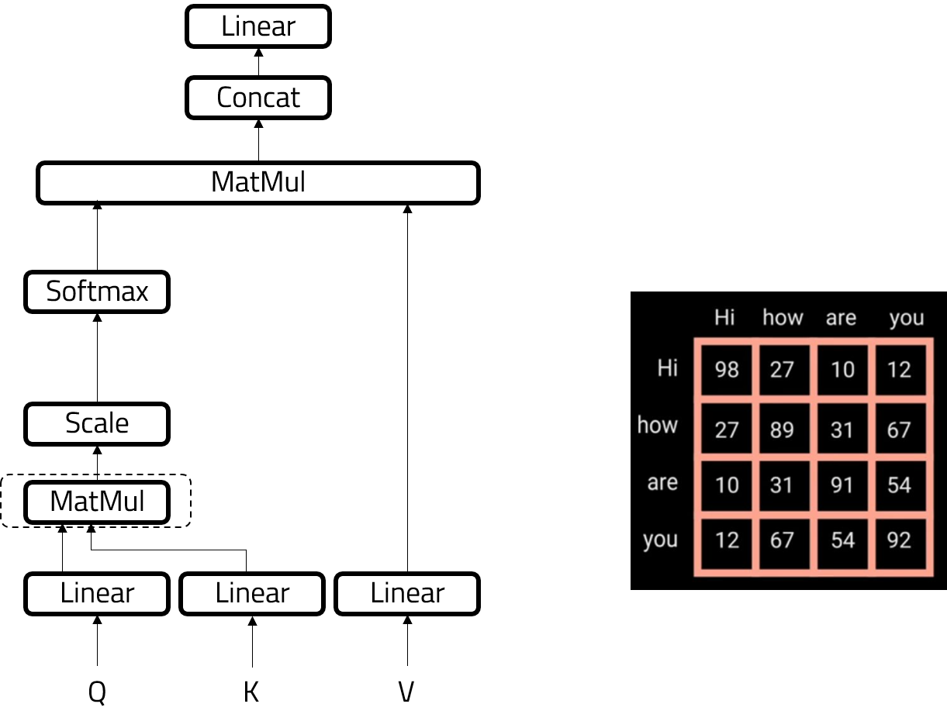
Introduction (Attention Mechanism)
An attention mechanism is usually implemented as dense matrix operations and softmax operations.
A dense matrix vector multiplication computes the similarity
across all search targets.
The computational complexity is therefore proportional to
the number of search targets.
For larger external knowledge base, or for longer sequence of data, the attention mechanism requires more computation.
The computational complexity is proportional to the square of the search targets, which becomes a limiting factor for the capacity of NN models.

Slide 5
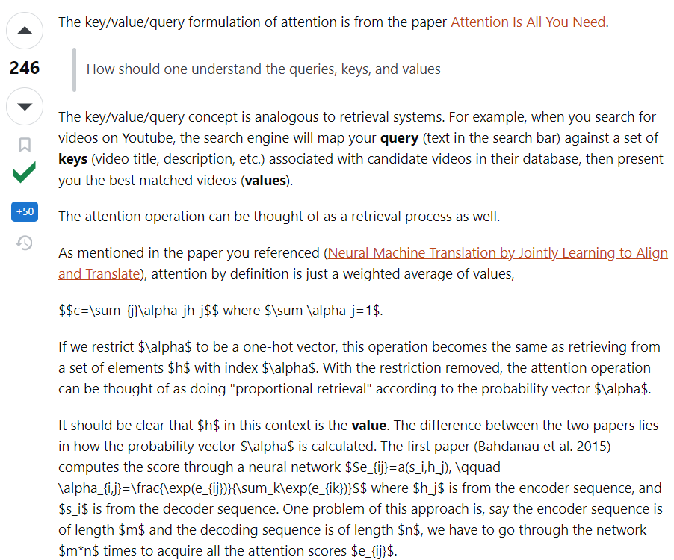
Understanding keys, queries and values

Slide 6
Proposed Solution
A hardware accelerator name A³ has been proposed for the implementation of attention mechanism.
Methods to reduce the amount of computation through algorithmic optimization and approximation is also presented.
A specialized pipeline has been proposed to exploit parallelism and datapath specialization to improve energy efficiency.
The proposed accelerator demonstrates orders of magnitude speedup and energy efficiency over conventional hardware.

Slide 7
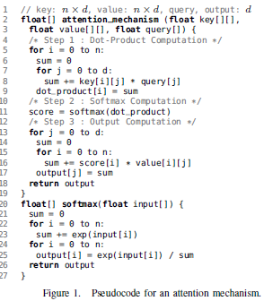
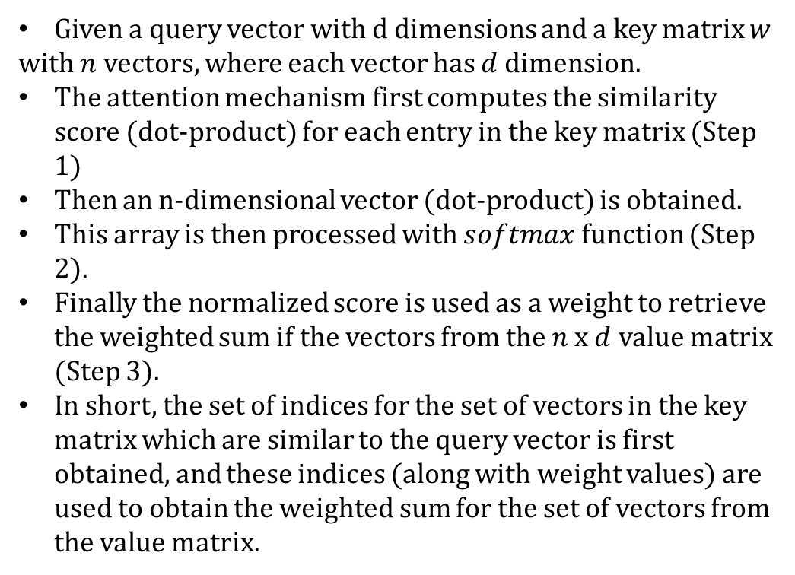
Attention Mechanism
Given a query vector with d dimensions and a key matrix $w$
with $n$ vectors, where each vector has $d$ dimension.
The attention mechanism first computes the similarity score (dot-product) for each entry in the key matrix (Step 1)
Then an n-dimensional vector (dot-product) is obtained.
This array is then processed with $softmax$ function (Step 2).
Finally the normalized score is used as a weight to retrieve the weighted sum if the vectors from the $n$ x $d$ value matrix (Step 3).
In short, the set of indices for the set of vectors in the key matrix which are similar to the query vector is first obtained, and these indices (along with weight values) are used to obtain the weighted sum for the set of vectors from the value matrix.

Slide 8
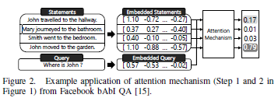
Attention Mechanism (Example)
A simple example shows how the attention mechanism is utilized to enable NN to find a sentence relevant to the question.
A list of statements are provided.
The goal is to find the right answer to the question.
4th statement is most relevant to the question and it is identified by the attention mechanism by performing a similarity search in the embeddings.
If multiple sentences are required to answer the question, it updates the query with relevant sentence found in the previous iteration and utilizes the attention mechanism again to retrieve other relevant sentences from the set.

Slide 9
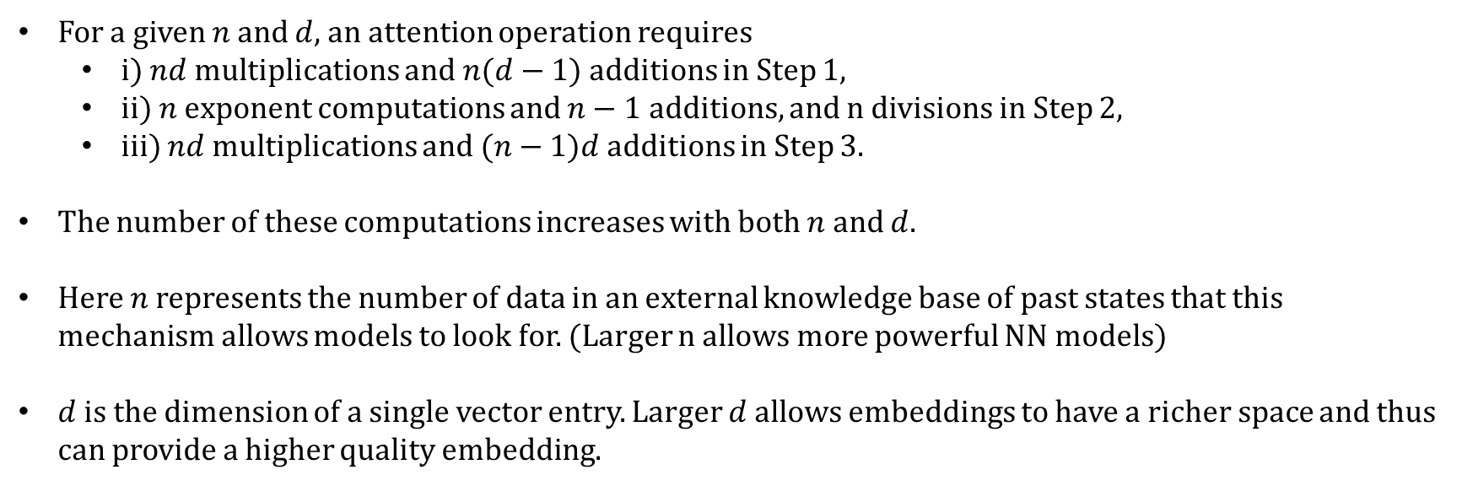
Cost of Attention Mechanism
For a given $n$ and $d$, an attention operation requires
i) $nd$ multiplications and $n(d−1)$additions in Step 1,
ii) $n$ exponent computations and $n−1$ additions, and n divisions in Step 2,
iii) $nd$ multiplications and $(n−1)d$additions in Step 3.
The number of these computations increases with both $n$ and $d$.
Here $n$ represents the number of data in an external knowledge base of past states that this mechanism allows models to look for. (Larger n allows more powerful NN models)
$d$ is the dimension of a single vector entry. Larger $d$ allows embeddings to have a richer space and thus can provide a higher quality embedding.

Slide 10
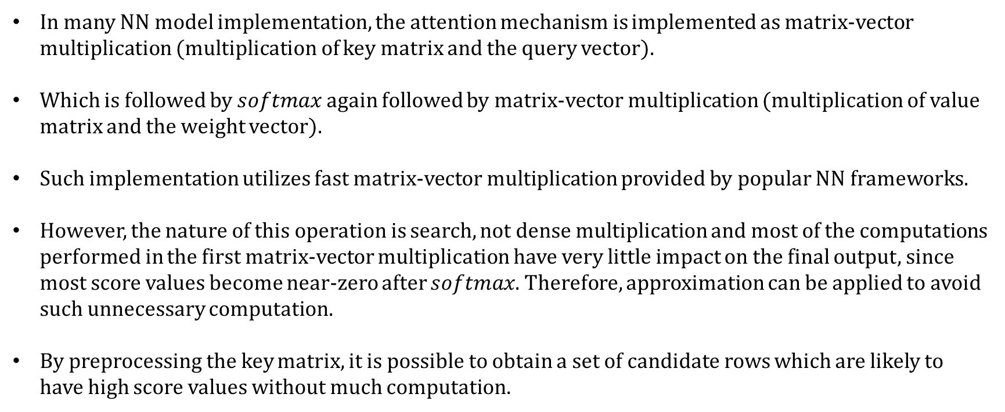
Opportunity for Approximation
In many NN model implementation, the attention mechanism is implemented as matrix-vector multiplication (multiplication of key matrix and the query vector).
Which is followed by $softmax$ again followed by matrix-vector multiplication (multiplication of value matrix and the weight vector).
Such implementation utilizes fast matrix-vector multiplication provided by popular NN frameworks.
However, the nature of this operation is search, not dense multiplication and most of the computations performed in the first matrix-vector multiplication have very little impact on the final output, since most score values become near-zero after $softmax$. Therefore, approximation can be applied to avoid such unnecessary computation.
By preprocessing the key matrix, it is possible to obtain a set of candidate rows which are likely to have high score values without much computation.

Slide 11
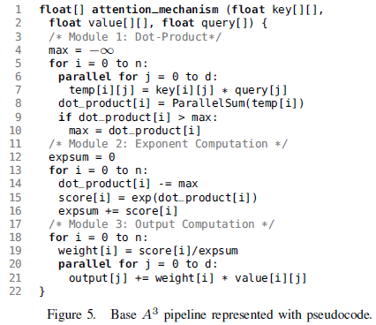
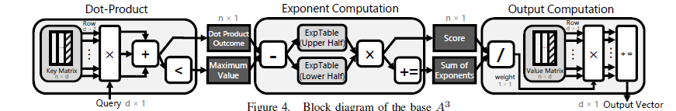
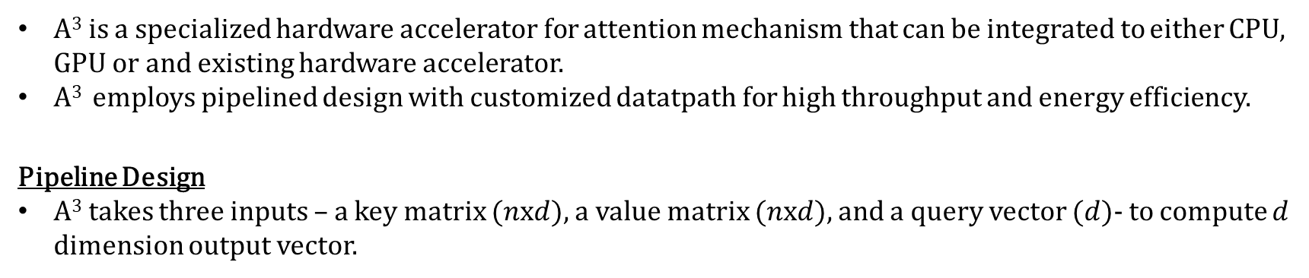
A³ Base Design
A³ is a specialized hardware accelerator for attention mechanism that can be integrated to either CPU, GPU or and existing hardware accelerator.
A³ employs pipelined design with customized datatpath for high throughput and energy efficiency.
Pipeline Design
A³ takes three inputs – a key matrix ($n$x$d$), a value matrix ($n$x$d$), and a query vector ($d$)- to compute $d$ dimension output vector.

Slide 12
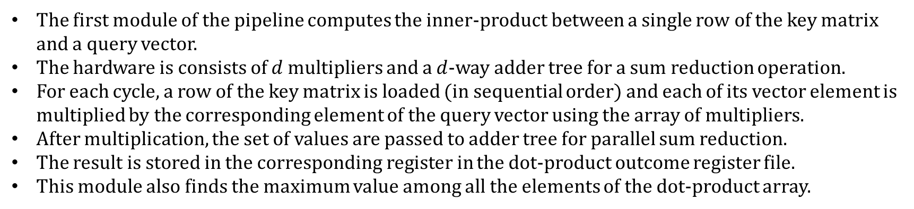
A³ Base Design – Module 1 – Dot Product Computation
The first module of the pipeline computes the inner-product between a single row of the key matrix and a query vector.
The hardware is consists of $d$ multipliers and a $d$-way adder tree for a sum reduction operation.
For each cycle, a row of the key matrix is loaded (in sequential order) and each of its vector element is multiplied by the corresponding element of the query vector using the array of multipliers.
After multiplication, the set of values are passed to adder tree for parallel sum reduction.
The result is stored in the corresponding register in the dot-product outcome register file.
This module also finds the maximum value among all the elements of the dot-product array.

Slide 13
A³ Base Design – Module 2 – Exponent Computation
This module computes the exponent of each dot-product value computed by Module-1.
Exponent function is implemented using a look-up table.
The module first starts with subtracting the maximum value of the input vector from the dot-product value being processed.
With this subtraction all elements of the input vector are normalized between 0 and 1.
To reduce the size of look-up table, the exponent function is decomposed into multiplication of two exponent operations.
With this transformation, two smaller look-up tables can be utilized with a multiplication, instead of a one large look-up table.
After exponent computation, the value is accumulated for later use as softmax denominator.

Slide 14
A³ Base Design – Module 3 – Output Computation
This module computes the output of the attention operation.
Every cycle, an element of the score vector is divided by the sum of all score values for normalization.
Then this value (weight) serves as a scaling factor for the corresponding row vector in the value matrix.
Each element of a row vector is multiplied by this value.
The result of this computation is accumulated in the output register and the process is repeated n times.

Slide 15

Thank You!

Slide 16
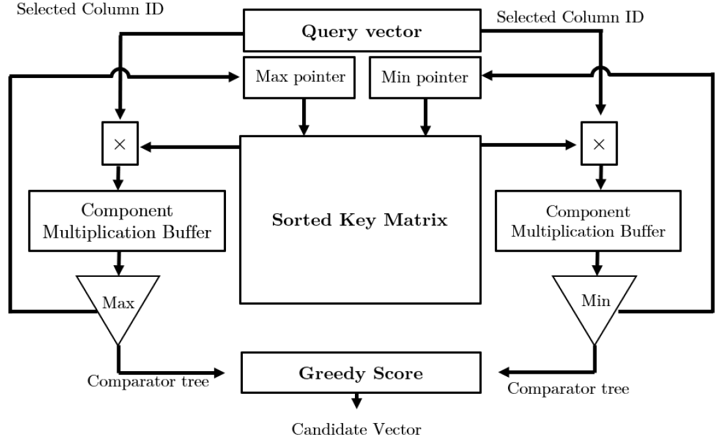

Slide 17
